Slide 1


SMART INDIA HACKATHON 2025
Problem Statement ID – SIH25058
Problem Statement Title - Detection and Prevention of Tampering in Weighing and Measuring instruments
Theme -
PS Category- Hardware
Team ID-
Team Name – Binary Brains

Slide 2
Tamper Detection in Weighing and
Measuring Instruments
Binary Brains
Common Problem
Every year, Indian consumers collectively lose an estimated ₹5,000 crore due to tampered weighing instruments and inaccurate measurements in trade markets.
The practice of tampering with measurement devices to manipulate readings has become a pervasive issue. This isn’t just limited to local where scales might be altered to give false weights. It's a far more widespread problem, affecting virtually all systems that rely on accurate readings. The problem isn't limited to commerce. It affects the accuracy of scientific measurements, the safety of products like medicine, and the integrity of data collected for research. For example, a tampered scale in a laboratory could lead to incorrect dosage calculations, with potentially dangerous consequences.
Problem Solution
This project aims to develop a robust and intelligent system to detect, prevent, and alert against tampering in weighing and measuring instruments.
Physical Tamper Alert: If the setup is disturbed or broken, an alert message will be recorded and stored in the provided SD card.
Anomaly Alert System:If the weighing instrument shows an abnormal or incorrect measurement, a warning message is generated and sent to the cloud for monitoring and record keeping.
Immutable Records:The records are checked through the web, and necessary actions are taken against clients or individuals involved in tampering

Slide 3
TECHNICAL APPROACH
Binary Brains
Technical Solution
The entire system is potted, and an LDR sensor is attached to detect any attempt to break into the setup. If tampering is detected, the data is sent to the cloud .In a digital weighing machine that is not always connected to Wi-Fi, the data is stored in an SD card. The machine stops working only if tampering is detected, and once it connects to Wi-Fi, the stored data is sent to the cloud.
The ADC in the digital weighing machine monitors for voltage spikes, while the MCU in the fuel dispenser cross-verifies the electric pulses with the digitally displayed values. If any error is detected, an alert is sent via the cloud
The MCU’s signature key is stored in the cloud. If any modification occurs, the signature key will mismatch, allowing tampering to be detected.
A GPS module is added to the setup to determine the location where tampering has occurred.
The light sensor is attached to a battery to ensure detection if the power source is disconnected before any physical tampering.
A smart nozzle is attached to the fuel flow to prevent the fuel from flowing backward.
Technologies Used
Light Sensor(LDR)
NEO-M8N GPS Module with Ceramic Active Antenna
HX711 – 24-bit ADC
CHANDOK Automatic Fuel Nozzles

Slide 4
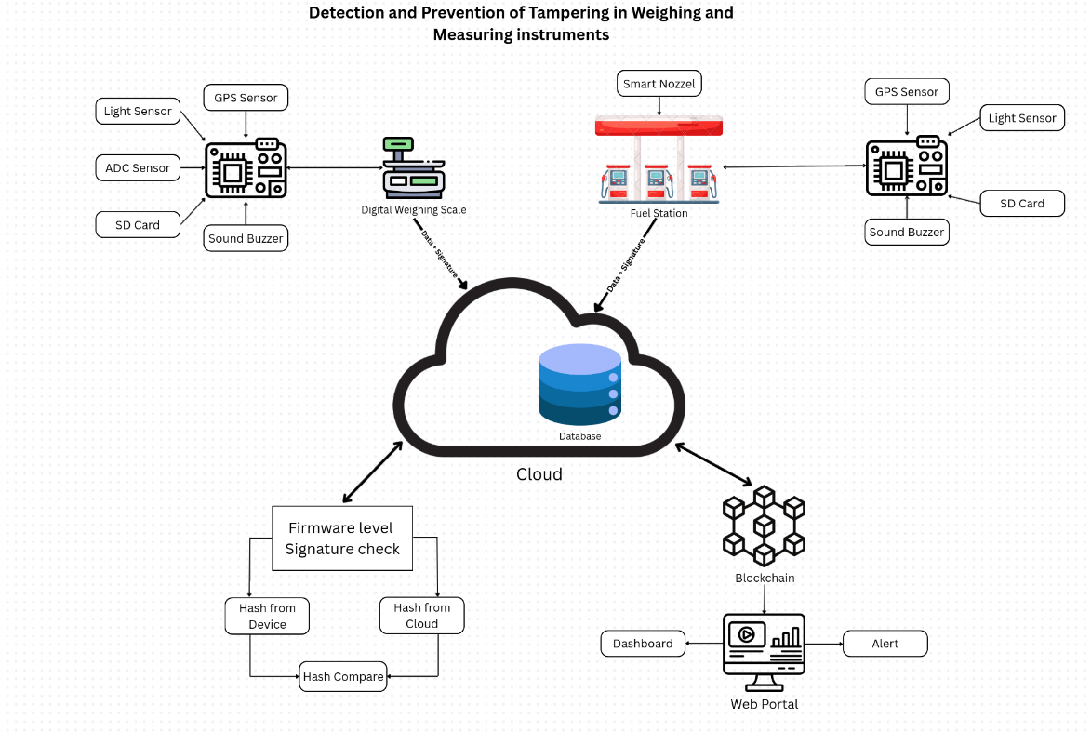
Flow Diagram
Binary Brains

Slide 5
Binary Brains
FEASIBILITY AND VIABILITY
Uses low-cost, easily available components such as LDR, HX711, pulse logger, and check valve.
Can be simply integrated with existing machines.
Requires minimal maintenance.
Prevents fraud, saving significant losses.
Offers high return on investment and builds trust and compliance in the market
Data can be monitored remotely in real-time, reducing the need for manual inspections.
The system can be deployed across multiple dispensers and weighing machines with little modification.

Slide 6
IMPACT AND BENEFITS
Binary Brains
Ensures accurate and reliable measurements.
Detects tampering, preventing fraud and financial losses.
Supports legal and industrial compliance.
Promotes responsible usage and reduces misuse.
Builds trust, transparency, and accountability.
Our project aims to attains following “Sustainable Development Goals”
Goal 8: Decent Work and Economic Growth – Protects businesses from losses due to tampering.
Goal 9: Industry, Innovation, and Infrastructure – Supports smart, reliable measurement systems in industries.
Goal 12: Responsible Consumption and Production – Prevents misuse and wastage of products or fuel.
Goal 16: Peace, Justice, and Strong Institutions – Strengthens trust, transparency, and accountability in commerce.
Goal 17: Partnerships for the Goals – Encourages collaboration between technology providers, regulators, and industries.

Slide 7
RESEARCH AND REFERENCES
Binary Brains
Tamper Detection in Industrial Sensors: An Approach Based on Anomaly Detection. William Villegas-Ch, Jaime Govea, Angel Jaramillo-Alcazar; Sensors, 2023.
Hardware Security Analysis of Smart Flow Meter in Fuel Dispensing Unit. Aakash V, Vinukumar A R, Anish S; IJIERT (India), 2021.
Fuel Monitoring System. S. P. Palaskar et al.; IJRASET, 2023.
Benchmarks for detecting Measurement Tang - F. Roger et al., arxiv (2023)*
Fuel dispenser tampering / fraud detection literate f Patents - (example) Us patentUS9817042 B21)
The ODSF implementation for fuel dispenses field surveillance/Conference paper

